Slide 1


Continental Retirement Plan (CARP) Overview for Technicians and Related Employees
April 2022

Slide 2
Definitions – Types of Service under CARP
Service Types:
Vesting service: is used to determine a participant’s right to the accrued benefit, eligibility for Early Retirement, and to determine eligibility for the Lump Sum Optional Form of Payment under CARP. Participants become vested in a benefit from the Plan when they complete five (5) years of vesting service or when reaching age 65.
Benefit service: is a component used in the calculation of a participant’s accrued benefit under the Plan. Participants will accrue benefit service as long as they are actively employed in an eligible workgroup. If a participant transfers to a workgroup that is not CARP eligible, the benefit service accruals will cease while vesting service will continue to accrue.

Slide 3
Other Important Definitions
Compensation (a.k.a. pensionable pay)*
Pay/compensation used in the calculation is regular pay
Excludes bonuses or commissions, severance pay, reimbursements for expenses, vacation paid after separation, Profit Sharing & on-time bonuses
The highest 5 consecutive years of pay out of the last 10 years
* Refer to the Continental Retirement Plan document for all the specifics on compensation eligibility

Slide 4
CARP Formula
What is Average Social Security Wage Base (ASSWB)?
It is the average of the Social Security wage base for the 35-year period that ends the year before the year you reach the Social Security Normal Retirement Age (age 65 through age 67 depending on when you were born).

Slide 5
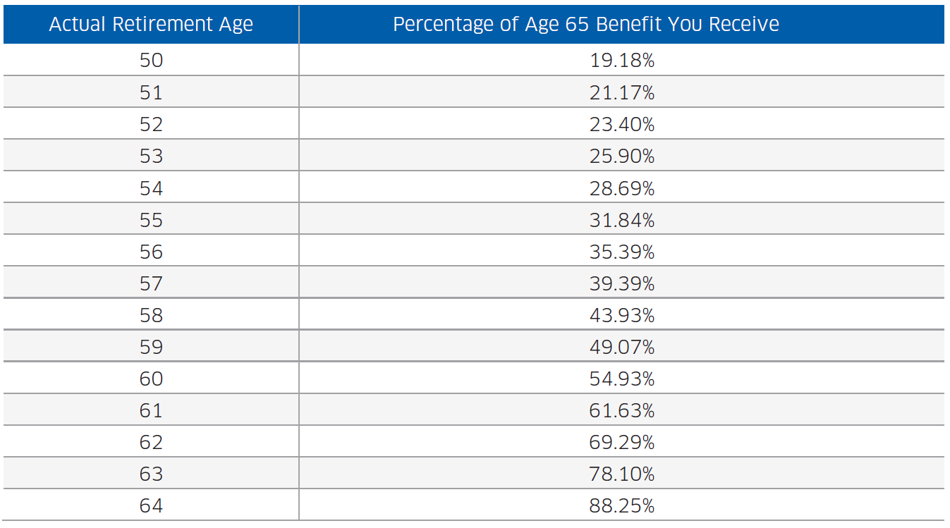
CARP Formula (cont’d)
Early retirement reduction factors
If you commence your benefit before Normal Retirement Age of 65, your benefit will be reduced

Slide 6
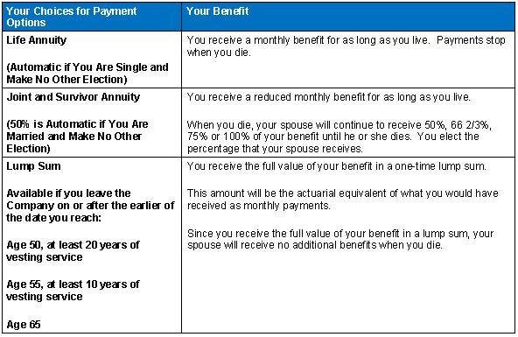
CARP Payment Options and Information

Slide 7
Interest Rates Used to Calculate Your Lump Sum Benefit
The IRS publishes three “segmented” interest rates each month. CARP specifies that we use these published rates in calculating the lump sum benefit (if applicable). For lump sums payable in the second half of the year, July 1 through December 31, we use the February rates published in March of that year. For lump sums payable in the first half of the year, January 1 through June 30, we use the August rates published by the IRS in September (of the prior year).
For example, if a participant wants to receive a lump using the interest rate payable in the first half of the year, the participant’s last day with the Company must be no later than May 31, with first payment beginning on June 1.

Slide 8
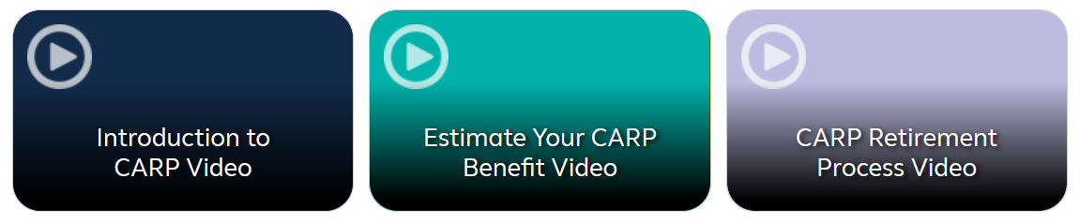
CARP Educational Videos
There are three short videos available for viewing on Your Benefit Resources
Introduction to CARP – focusing on an introduction to CARP
Estimate Your CARP Benefit – walking through how to run a simple pension estimate
CARP Retirement Process – discussing steps to take to start the CARP benefit
To view the videos, log on to Flying Together > Employee Services > Financial Wellness > Your Benefits Resources™ (YBR) > Savings & Retirement

Slide 9

For More Information
Participants are able to run benefit projections via Your Benefits Resources™ (YBR). Flying Together > Employee Services > Financial Wellness > Your Benefits Resources™ (YBR) > Savings & Retirement and click on this tile:
Other more detailed or participant-specific CARP questions should be directed to the United Airlines Benefits Service Center at 1-800-651-1007, between 7:00 a.m. and 7:00 p.m. Central time, Monday through Friday.
Help Hub is available to you when you have other questions, or you need more assistance. Flying Together > Employee Services > Tools and Resources > Help Hub.

